Slide 1
Joins and Melts

Slide 2


Slide 3
Base R: merge()
We can merge two data frames in R by using the merge() function.
The data frames must have same column names on which the merging happens.
merge() in R is similar to database join operation in SQL.
The different arguments to merge() allow you to perform
natural joins
as well as left, right, and full outer joins

Slide 4
merge() arguments
x: data frame1.
y: data frame2.
by,x, by.y: The names of the columns that are common to both x and y. The default is to use the columns with common names between the two data frames.
all, all.x, all.y: Logical values that specify the type of merge. The default value is all=FALSE (meaning that only the matching rows are returned).

Slide 5
Understanding different types of join

Slide 6
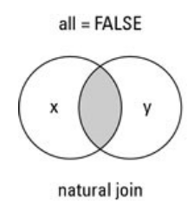
Natural join
To keep only rows that match from the data frames, specify the argument all=FALSE.

Slide 7
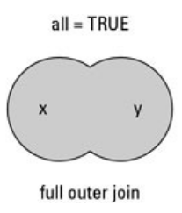
Full outer join
To keep all rows from both data frames, specify all=TRUE.

Slide 8
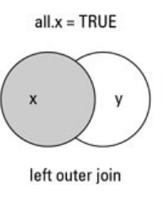
Left (right) outer join
To include all the rows of your data frame x
Only those from y that match, specify x=TRUE.

Slide 9
Example
# data frame 1
df1 = data.frame(id = c(1:6), area = c(rep(“a", 3), rep(“b", 3)))
df1
# data frame 2
df2 = data.frame(id = c(2, 4, 6), gender = c(rep(“m", 2), rep(“f", 1)))
Df2
# inner join
merge(x=df1, y=df2, by=“id”)

Slide 10
Join function in dplyr
Provides equivalent joins to merge()
And fills in the gaps with SQL joins

Slide 11
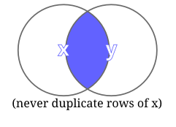
semi_join()
Return all rows from x where there are matching values in y, keeping just columns from x. A semi join differs from an inner join because an inner join will return one row of x for each matching row of y, where a semi join will never duplicate rows of x. This is a filtering join.

Slide 12
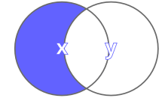
anti_join()
Return all rows from x where there are not matching values in y, keeping just columns from x. This is a filtering join.

Slide 13
Melting and Casting
Changing the shape of the data set
Useful for plotting in ggplot2 (requires ‘log’ data)
Provides consistency
Allows combining of data sets

Slide 14
melt()
Takes data in wide format and stacks a set of columns into a single column of data.
Specify a data frame, the id variables (which will be left at their settings) and the measured variables (columns of data) to be stacked.
Default assumption on measured variables is that it is all columns that are not specified as id variables.

Slide 15
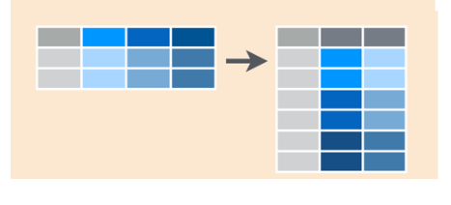

Slide 16
cast() or dcast()
Aggregation occurs when the combination of variables in the cast function does not identify Individual observations.
In this case cast function reduces the multiple values to a single one by summing up the values in the value column.

Slide 17
